Slide 1
Cryptography
EN.600.444/644
Fall 2019
Dr. Seth James Nielson

Slide 2
This is NOT a Cryptography Class
And your textbook is not a crypto book
Optional: “Handbook of Applied Cryptography” (HAC)
We will not be discussing the mathematics
Focus on “black box” crypto primitives
Hashing
Symmetric Operations
Asymmetric Operations

Slide 3
Some Terminology
Cryptography – How to encrypt
Cryptanalysis – How to break ciphers
Cryptology – Cryptography + Cryptanalysis
Plaintext/Ciphertext – Unencrypted/Encrypted
Ciphers – Mechanisms for encrypting (stream/block)
Symmetric - Shared key
Asymmetric - public/private key
Digital signatures
Hash functions – One-way functions

Slide 4
The Cryptography Problem
Cryptography underlies almost all modern computer security
Yet, it is surprisingly hard to use correctly
Let’s review some history

Slide 5
Early Subst. Cipher
Substitution Ciphers
For example, monoalphabetic substitution (Caesar cipher)
Easy to break; strengthen with block or stream ciphers
Let’s race! Decrypt the following:
RYG WKXI CSLVSXQC NY IYE RKFO
It’s a question, when you decrypt it, shout out the answer
First one to decrypt it wins a prize

Slide 6
Early Stream Cipher
Vigenere Cipher
PLAINTEXT: YOUPASSEDTHECLASS
KEY: PUPPYPUPPYPUPPYPUPPY
CIPHERTXT: NIJEYHMTSRWYRAYHM
Still breakable with enough text
Playfair – Early Block Cipher
Much harder to break because it’s encoding digraphs
Changing one letter in plaintext still changes one letter in ciphertext

Slide 7
Early Block Cipher
Playfair Cipher
Much harder to break because it’s encoding digraphs
https://learncryptography.com/classical-encryption/playfair-cipher

Slide 8
Early One-Way Functions
Bank transfers in the 19th century used the telegraph
How to keep a telegraph operator from sending a false message?
Banks developed code but this did nothing for message integrity
Money was the motivator to distinguish from message confidentiality
Banks developed code books with a “test key”
The test key had one-way calculations for money, dates, currency, etc
The test key computed and the test key transmitted had to match
Not great by today’s standards, but worked until the 1980’s!!!

Slide 9
One-way Functions
Avalanche Property – 1 bit change impacts 50% of output
“Hard” to invert
Preimage resistance – cannot find input for specified output
Second preimage resistance – cannot find 2nd input for output
Collision resistance – cannot find 2 inputs with same outputs

Slide 10
Brute Force on Hashes
Iterate through possible preimages for an output:
Open Python3 interactive shell
Import hashlib
h = hashlib.sha1(b’a’).hexdigest()
bin(int(h, 16))
Find an input x such that the LSb is 1
Find an input x such that the LSB’s are 01
Find an input x such that the LSB’s are 110

Slide 11
“Breaking” Hashes
Birthday attack on hashes
Find a collision in 2^(n/2) attempts
n is the size of the hash in bits
Brute force should take 2^(n/2). Anything less is broken
(This doesn’t mean that it is practical)

Slide 12
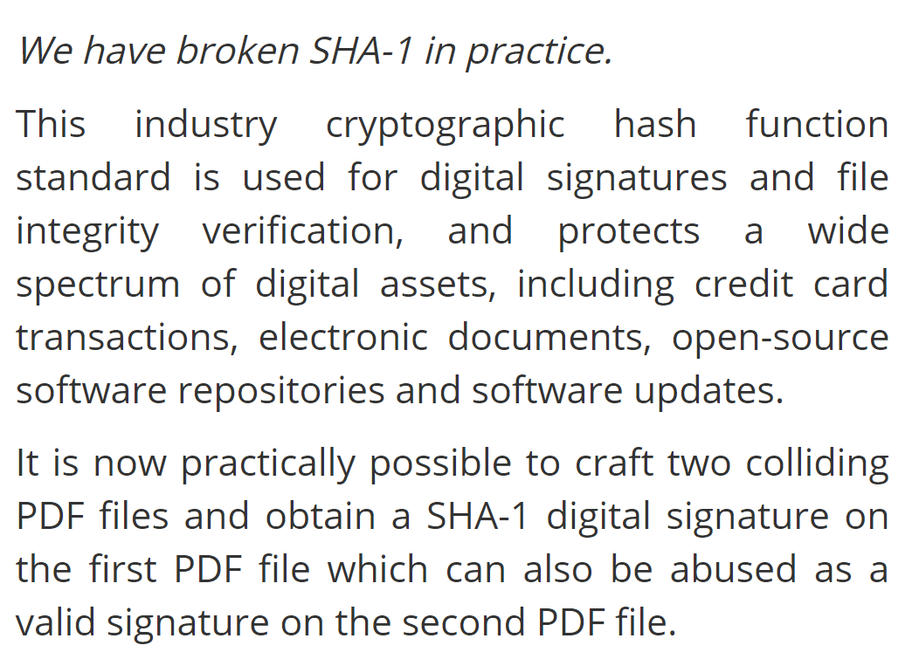
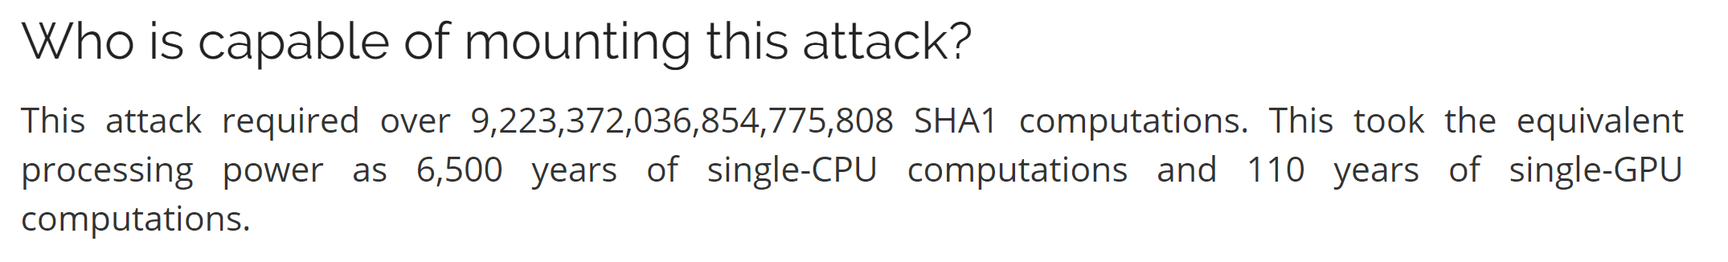
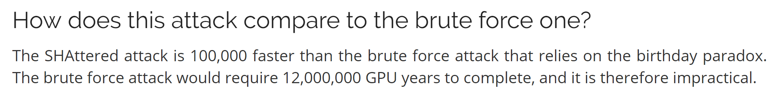
SHA-1 is now Obsolete

Slide 13
Responsible Reporting
“We have broken sha-1 in practice”
Irresponsible, in my opinion.
To the average user of crypto, what does this mean?
Every single context/application/use?
Every single crypto algorithm that uses SHA1 (eg HMAC)?
Nevertheless, stop using SHA-1 in all new deployments

Slide 14
Symmetric Crypto
Unlike hashing, we now assume we can recover the data
Symmetric – Same key to encrypt and decrypt
Parties in a communication must share a key
Two major types:
Block cipher (encrypt a block at a time)
Stream cipher (create a stream to xor with plaintext)

Slide 15
“Good” Block Ciphers
Avalanche property, just like hashing
“Large” block sizes for block ciphers
DES uses a 64 bit block (deprecated)
AES uses a 128 bit block
In addition to “large” blocks, a way of “chaining” the blocks together

Slide 16


An Example of Unchained Blocks

Slide 17
Cryptographic Modes
This mode is called “Electronic Code Book” (ECB) mode
For the love of all that is holy, DON’T USE IT!
It is simply for testing and training purposes

Slide 18
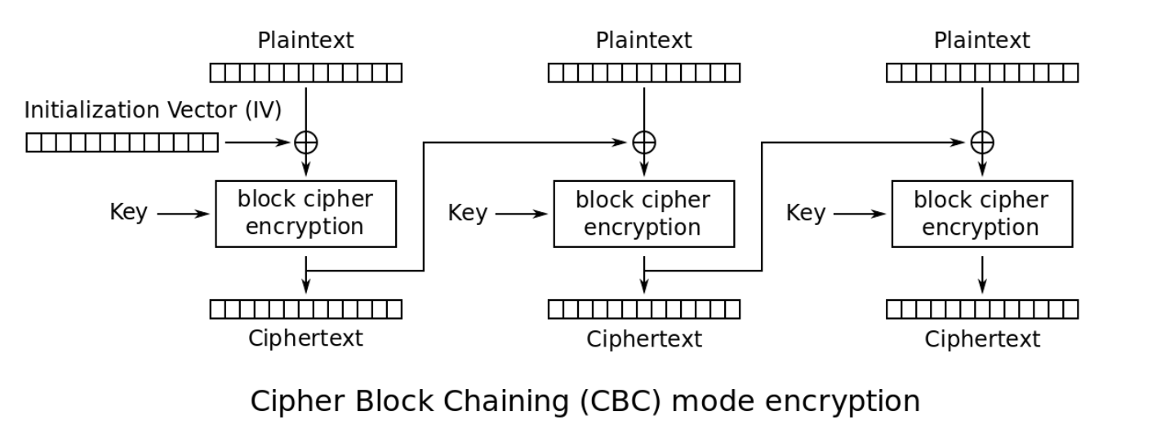
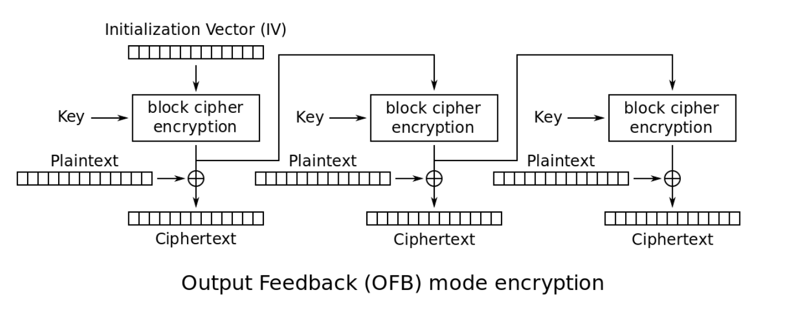
Common Chaining
Cipher Block Chaining (CBC)
Output Feedback (OFB)

Slide 19
Cipher-Block-Chaining-Mode
Eliminates any patterns from the plaintext
However, you can change any one cipher block and it will only affect 2 plaintext blocks
Don’t rely on CBC for message integrity
The IV is critical. There was an attack on older SSL versions where the IV was predictable

Slide 20
Stream Ciphers
Despite being a “block” mode, OFB is a stream cipher
One-time pad is not a streaming cipher, but similar
OTP is the only provably “secure” cipher (confidentiality)
Key must be the same length as the plaintext!
XOR the key with the plaintext
Stream cipher takes a shorter key and generates key stream

Slide 21
Deriving a Stream from a Block Cipher
Output-Feedback (OFB) Mode
Encrypt an IV, then encrypt the output, and the output of that…
Xor the stream with your plaintext to get the cipher-text
This is called an additive stream cipher
Counter (CTR) mode
Encrypt (IV + i) and xor (another additive stream cipher)
Embarrassingly parallel

Slide 22
Don’t Reuse a Key Stream!!!
If you reuse the same key stream, you’re in big trouble.
C1 = K1 xor M1
C2 = K1 xor M2
C1 xor C2 = K1 xor M1 xor K1 xor M2
= K1 xor K1 xor M1 xor M2
= M1 xor M2 (if either message is natural language, easy to figure out)

Slide 23
Don’t Trust a Stream-Encrypted Message
Suppose an attacker knows the plaintext M1
If attacker can man-in-the-middle, can change the message
C1 = K xor M1
Attacker produces C2 = C1 xor (M1 xor M2)
= K xor M1 xor M1 xor M2
= K xor M2
ALSO WORKS ON OTP (“provably secure”)
Know what “secure” means (CONTEXT)

Slide 24
MAC
MAC: Message Authentication Code
CBCMAC: last encrypted block from CBC encryption
Proved to be “secure” if the message length is fixed
HMAC_k(M) = h(k xor A, h(k xor B, M))
A = repeated 0x36
B = repeated 0x5c
Neither CBC-MAC or HMAC are parallelizable

Slide 25
Composite Mode
Integrity + Confidentiality
One possibility, compute MAC with one key, and CBC with a different key
Another possibility is CCM => Counter mode with a CBC-MAC
AES-GCM is also pretty neat if you feel up to it
Parallelizable

Slide 26
Asymmetric Primitives
A public/private key pair
Let the whole world know the public key
But only the “owner” knows the private key
The world can send messages to the owner
Public key can encrypt, private key can decrypt
The owner can sign messages to the world (Digital Signature)
Owner hashes message – H(M)
Owner encrypts H(M) with private key – E(H(M))
Owner sends message with signature – M + E(H(M))
World can verify… IF they trust the public key

Slide 27
Practical Asymmetric Uses
Encrypted Communication between A and B
A and B have each other’s public key
A encrypts a message for B under B’s public key
B responds by sending A a response under A’s public key
Works fine but…
It is very slow (asymmetric encryption/decryption is expensive)
Session keys are preferable

Slide 28
RSA
Very popular asymmetric cipher
MANY ATTACKS when NO PADDING IS USED
Encryption padding schemes
PKCS 1.5 (BROKEN!)
OAEP
Signature padding schemes
PKCS 1.5 (BROKEN!)
PSS

Slide 29
Using Public Keys for Key Exchange
Suppose you have keys with the property that they are commutative
So, you can exchange a session key between A and B this way
A and B have commutative keys Ka and Kb
A generates a session key Kab
A encrypts Kab under its key Ka: E_Ka(Kab)
A sends this to B, and B encrypts: E_Kb(E_Ka(Kab))
B sends this to A, but it’s commutative: E_Ka(E_Kb(Kab))
A decrypts and sends back: E_Kb(Kab)
Now B decrypts and gets Kab

Slide 30
Diffie Hellman Key Exchange
Not quite like what was described in previous slide, but similar principles
As described in the book:
A → B : g^{RA} (mod p)
B → A : g^{RB} (mod p)
A → B : {M}g^{RARB}
Session key g^{RARB} has perfect forward secrecy and (if destroyed) backward secrecy
But how do A and B know whom they are talking to?
Using traditional public keys, RA and RB can be sent authenticated and encrypted

Slide 31
Certification
How do we know that a public key actually belongs to some identity
The original proposed solution was a semi-trusted phone book
By “semi-trusted” it is simply published in so many places it is “easy” to find a valid version
What we use to day is to have one or two (or forty) trusted well-known public keys
All other keys are signed by these trusted keys

Slide 32
TLS version 1.0 RSA Key Exchange
Client sends
“Client Hello” message with a “ClientHello.random”
Server responds
“Server Hello” message with a “ServerHello.random”
“Server Certificate” (preferably signed by a trusted key)
“Server Done”
Client responds
Generates pre-master secret (PMS) of protocol version + random sequence
“Client Key Exchange” includes PMS encrypted under public key of server
“Verify” with a hash of all messages sent so far

Slide 33
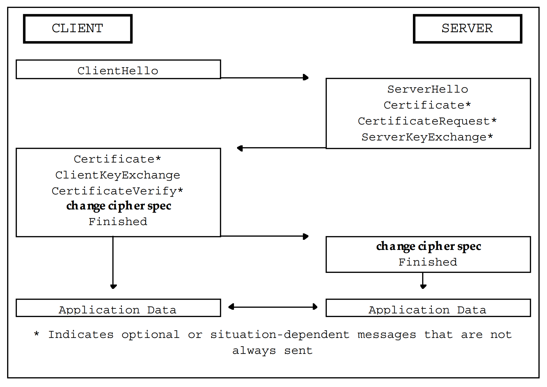
TLS V1 Handshake Visualized

Slide 34
Master Secret
Derived from pre-master secret
Pre-master secret computed directly from DH
Or, can exchange pre-master secret encrypted with pub key
master_secret = PRF(pre_master_secret, "master secret",
ClientHello.random + ServerHello.random)
[0..47];

Slide 35
TLS 1.0 PRF
Pseudo Random Function
PRF(secret, label, seed) = P_MD5(S1, label + seed) XOR P_SHA-1(S2, label + seed);
S1 = first half of secret
S2 = second half of secret

Slide 36
TLS 1.0 Data Expansion
P_hash(secret, seed) = HMAC_hash(secret, A(1) + seed) +
HMAC_hash(secret, A(2) + seed) +
HMAC_hash(secret, A(3) + seed) + ...
A() is defined as:
A(0) = seed
A(i) = HMAC_hash(secret, A(i-1))

Slide 37
TLS 1.0 Key Block
key_block = PRF(SecurityParameters.master_secret, "key expansion", SecurityParameters.server_random + SecurityParameters.client_random);
client_write_MAC_secret[CipherSpec.hash_size]
server_write_MAC_secret[CipherSpec.hash_size]
client_write_key[CipherSpec.key_material]
server_write_key[CipherSpec.key_material]
client_write_IV[CipherSpec.IV_size]
server_write_IV[CipherSpec.IV_size]

Slide 38
TLS 1.0 Finished Msg
verify_data = PRF(master_secret, finished_label, MD5(handshake_messages) + SHA-1(handshake_messages)) [0..11];

Slide 39
TLS 1.1
Attempted to fix various problems with TLS 1.0
CBC IV’s (explicit v implicit)
Now included in record
Prior to1.1, IV was last ciphertext block of previous record
Padding errors now just return error “bad_record_mac”
•Sometimes called the forgotten middle child

Slide 40
TLS 1.2
PRF replaced MD5/SHA1 with cipher suite specific function
Signatures explicitly identify hashing algorithm
Support for authenticated encryption
Changes to resist known attacks against previous versions

Slide 41
TLS 1.2 Handshake

Slide 42
PRF
In the base RFC, always uses SHA-256
Newcipher suites must define their PRF function
SHOULDuseSHA-256

Slide 43
Data Expansion

Slide 44
PRF Definition

Slide 45
Computing Master Secret

Slide 46
Computing Keys

Slide 47
New: AEAD Type

Slide 48
AEAD
Authenticated Encryption with Additional Data
Plaintext is simultaneously encrypted and integrity protected.
Default TLS 1.2 algorithms: CCM and GCM
No MAC key

